Slide 1

Design Patterns Revisit
Add new features to legacy code through Refactoring,
Design Patterns, and Copilot.
ODDS |
ทำ software ต้องสนุก
เราจะเก่งขึ้นทุกวัน
โอฬาร อึงอำนวยพร (โอ)

Slide 2
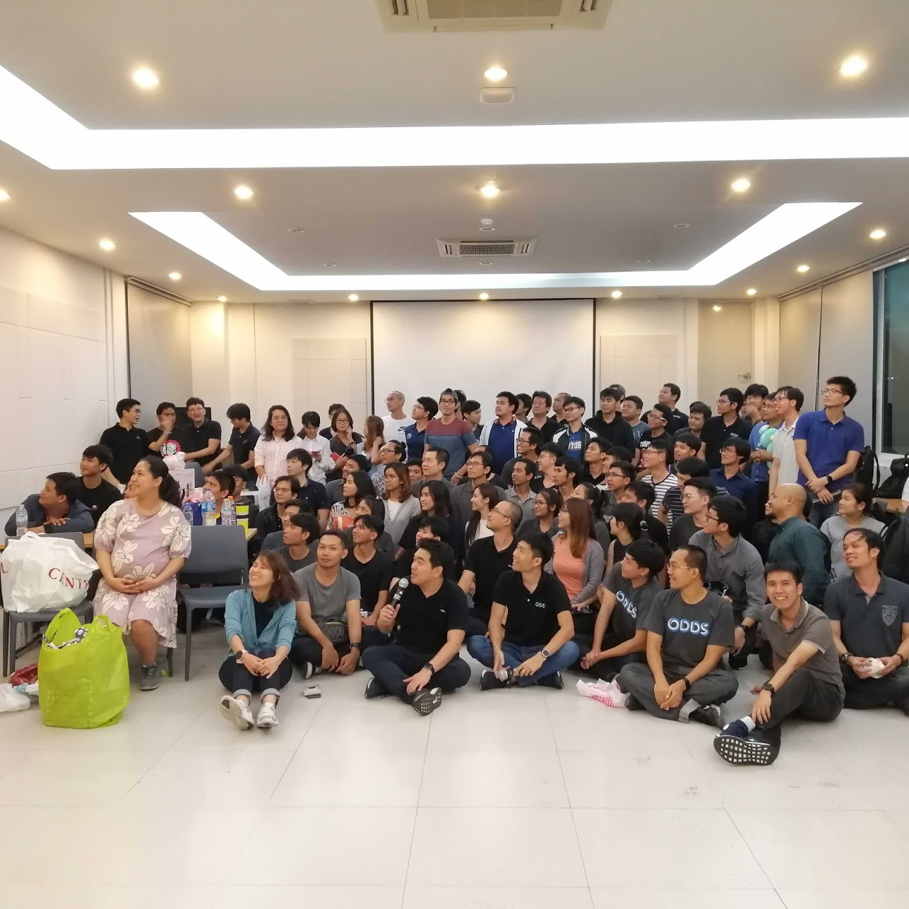



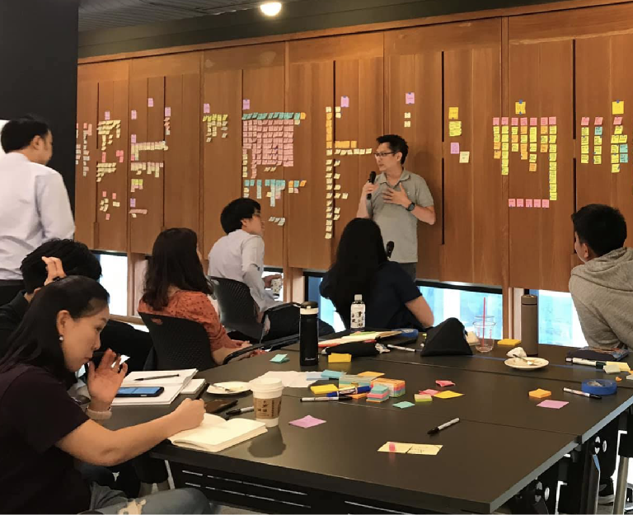

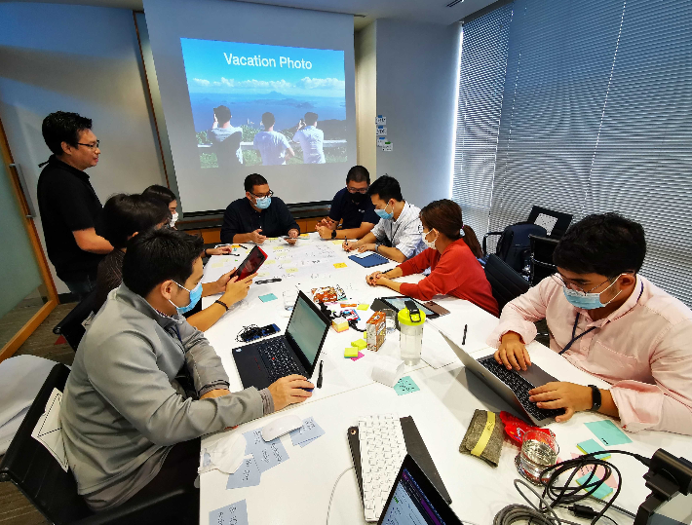

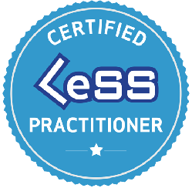

About me
Olarn Ungumnuayporn olarn.u@gmail.com
ODDS https://web.facebook.com/oddsteam
Agile Practitioner, Software Developer, Scrum Master, Agile Coach
Ex-Certified Scrum Master, LeSS Practitioner, Kanban, Flight Levels

Slide 3
Software always change!
if customers / users still want it.
Distribution of Maintenance Effort [15] illustrates that for any software, the changes are always expected and their distribution according to a survey is clarified here thus maintenance is the second major factor for fighting architecture erosion. Lifetime of software is elongated when there is high maintainability thus lowering development risks. Maintainability is also considered as a quality attribute that only focuses on the existing short-range attempts for changes but does not emphasize on the long-standing conservation of the software. For example, the maintainability of a software system can be enhanced by improving the quality of designs and code but it would not have any sufficient affect on the capability of the software for evolvability. Maintenance activities do not consider the structural modifications as they are not involved in the maintainability of the software systems because any addition to software can result in code clones thus reducing maintainability and leading towards architecture erosion. Therefore evolvability should be considered as a separate quality attribute factor necessary for software architecture consistency.
Reference: https://www.researchgate.net/figure/Distribution-of-Maintenance-Effort-15-illustrates-that-for-any-software-the-changes_fig5_271644986

Slide 4
















Things we’re talking about software development
on this day…
Native/Hybrid Cloud
Low-Code No-Code
Infra as Code
Agile
K8S
Docker
Domain-Driven Design
Serverless
A.I
CQRS
Blockchain
Java, Python,...
ArgoCD
New node.js as PHP
Clean Architecture
DevSecDataUxAIGitOps
and much more…

Slide 5
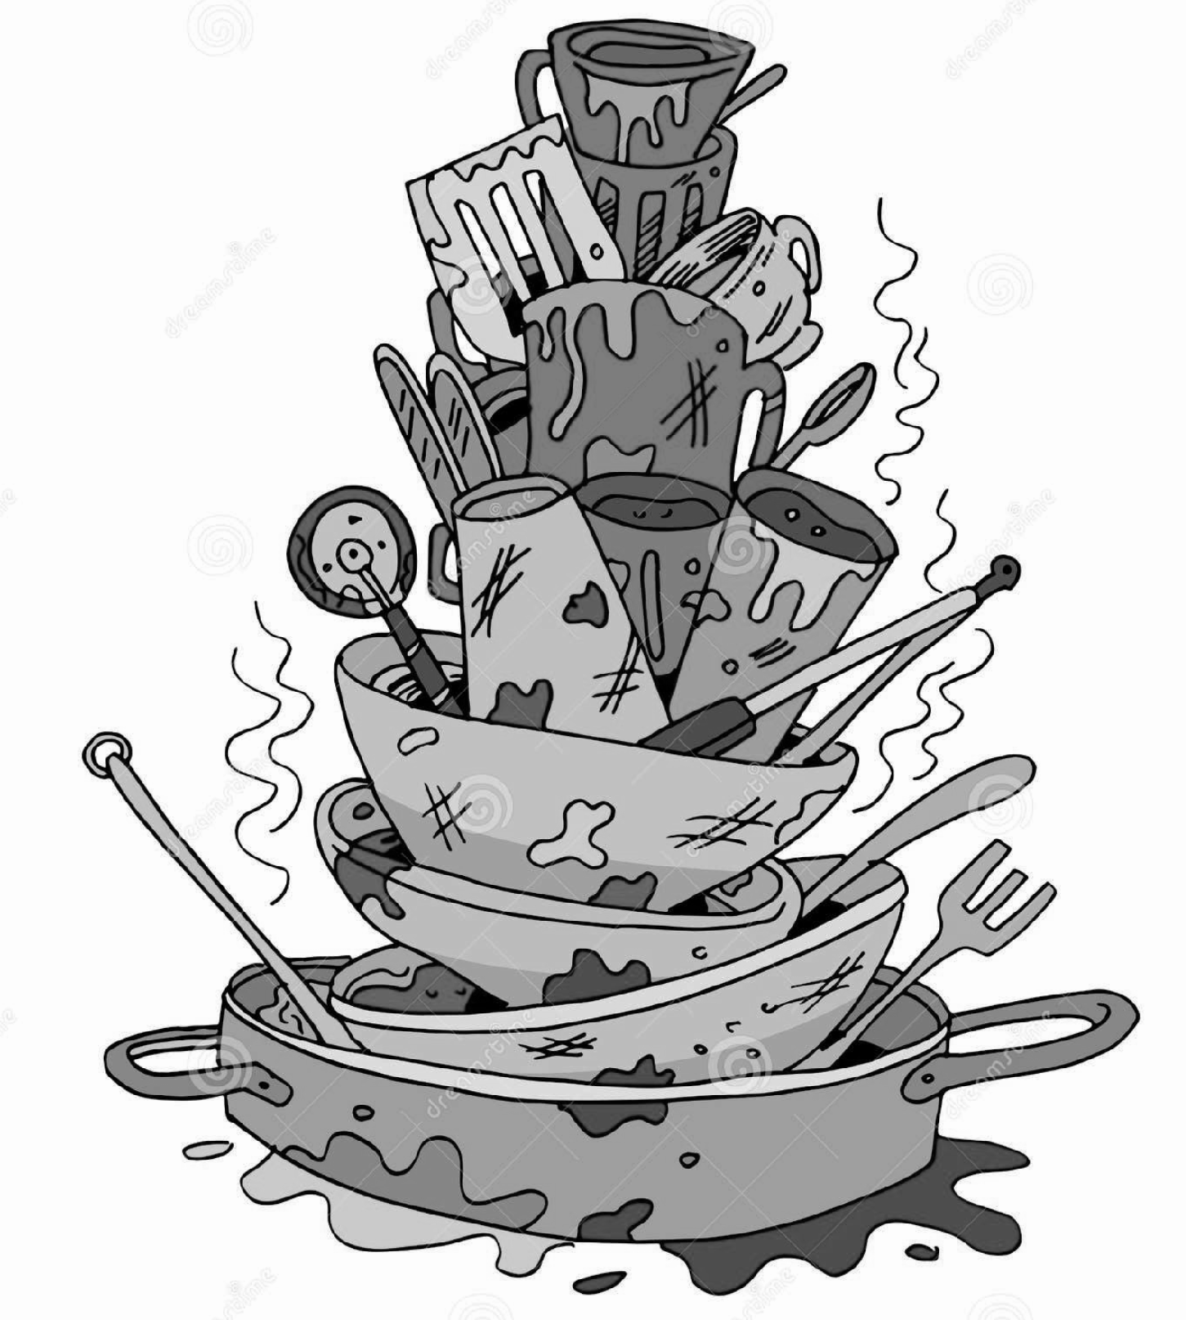
Legacy Code
…However, one thing that may be unavoidable is …

Slide 6
Legacy code
will hurt the one who trying to fix it!

Slide 7
How might we…

Slide 8
Code Craftsmanship

Slide 9

Manifesto for Agile Software Development
We are uncovering better ways of developing software by doing it and helping others do it. Through this work we have come to value:
Individuals and interactions over processes and tools Working software over comprehensive documentation Customer collaboration over contract negotiation Responding to change over following a plan
That is, while there is value in the items on the right, we value the items on the left more.
Twelve Principles of Agile Software

Slide 10
Principles behind the Agile Manifesto
We follow these principles:
Our highest priority is to satisfy the customer through early and continuous delivery of valuable software.
Welcome changing requirements, even late in development. Agile processes harness change for the customer's competitive advantage.
Deliver working software frequently, from a couple of weeks to a couple of months, with a preference to the shorter timescale.
Business people and developers must work together daily throughout the project.
Build projects around motivated individuals. Give them the environment and support they need, and trust them to get the job done.
The most efficient and effective method of conveying information to and within a development team is face-to-face conversation.
Working software is the primary measure of progress.
Agile processes promote sustainable development. The sponsors, developers, and users should be able to maintain a constant pace indefinitely.
Continuous attention to technical excellence and good design enhances agility.
Simplicity--the art of maximizing the amount of work not done--is essential.
The best architectures, requirements, and designs emerge from self-organizing teams.
At regular intervals, the team reflects on how to become more effective, then tunes and adjusts its behavior accordingly.

Slide 11
Code review…
do you ever…
Clean Code: A Handbook of Agile Software Craftsmanship, Robert C. Martin
https://www.amazon.com/Clean-Code-Handbook-Software-Craftsmanship/dp/0132350882

Slide 12
Responding to Change
Agility Mentality with Technical Excellence
Following a Plan
Over
drive
Responsive Feature
support
Continuous Delivery
Internal Codebase Quality
build
Continuous Integration
enable
improve
enable
Self-Testing Code
culture
Refactoring
Start here…
can
Martin Fowler - Thoughtworks XConf Bangkok 2018

Slide 13
However…
Technical excellence is the responsibility of developers,
even in the difficult situations.

Slide 14





When you’re dealing with legacy code
technical excellence is your friend.
Refactoring
End-to-end automation test
Test-Driven Development
Continuous Integration Culture
Design Patterns
Quality Code Coverage

Slide 15

Refactoring
require self-tested code.
Refactoring is the process of restructuring existing computer code without changing its external behavior.
Refactoring is a common practice in software development, and it can be used to make code more readable, maintainable, extensible, and efficient.
Improved code readability and maintainability.
Increased code extensibility.
Improved code efficiency.
Martin Fowler with contributions by Kent Back
https://shorturl.at/ektMX

Slide 16
GoF Design Patterns
…stand for Gang of Four
Almost 30 years ago (Oct 31, 1994) the iconic computer science book “Design Patterns: Elements of Reusable Object-Oriented Software” was first published.
The four authors of the book: Erich Gamma, Richard Helm, Ralph Johnson, and John Vlissides, have since been dubbed “The Gang of Four”, or GoF.

Slide 17
Demo
let’s Refactoring & use Design Pattern.
export enum PlanType {
UNKNOWN = 'Unknown',
BASIC = '1 THB per minute. Minimum pay 30THB/month.’,
VALUE = '0.5 THB/min for first 30 minutes. 1 THB/min thereafter. Min pay 30THB/month.’,
// new requirements
NIGHT_PACK = 'free from 6pm to 6am. 1 THB/min thereafter. Min 30 THB/month.’,
BIZ_VALUE = 'free from 9am to 6pm. 1 THB/min thereafter. Min 30 THB/month.’,
}
export class Billing {
calculatesMonthlyFee(transactions: Transaction[], plan: PlanType): number { . . . }

Slide 18
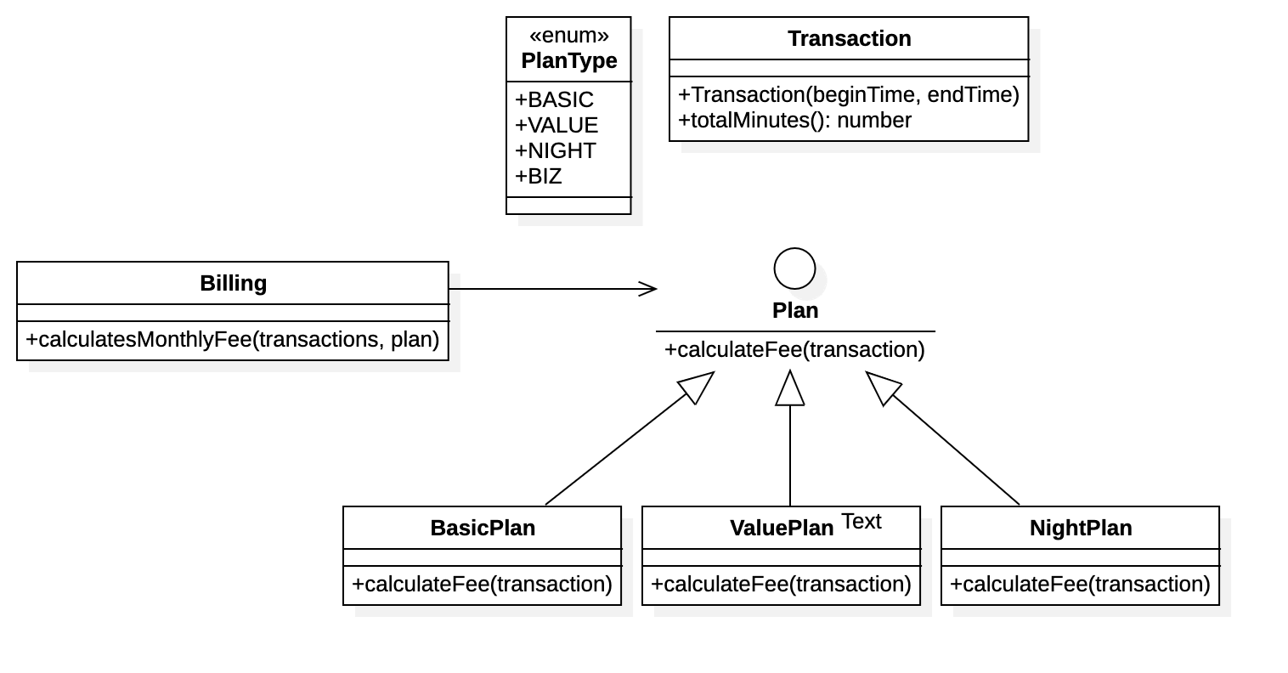
Strategy Pattern
in UML Diagram

Slide 20
Conclusion
Legacy code happens today. Right now when you write bad code.
Bad code is the code that difficult to add new functionality, fragile, hard to understand.
Technical excellence is the responsibility of developers, even in the difficult situations.
Technical craftsmanship take time, effort and practices. Design Patterns is just a small parts of it.
Some tips…
Build continuous improvement team culture. Be humble, respect, be inspired.
Learn from someone who know about it. Practice coding kata. bug badge, etc,
Read books, lots of it.
Happy coding ❤️

Slide 21


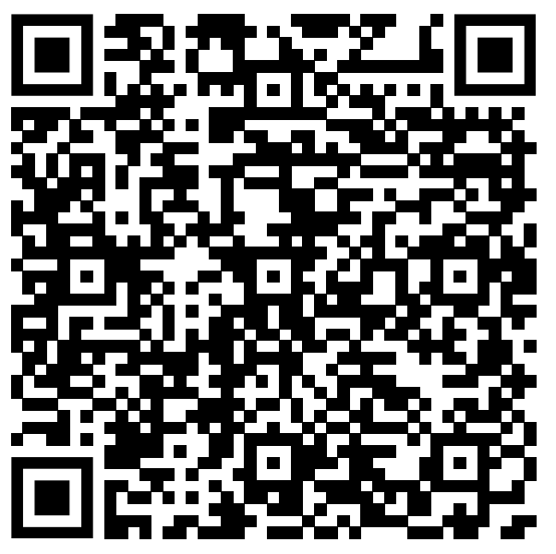
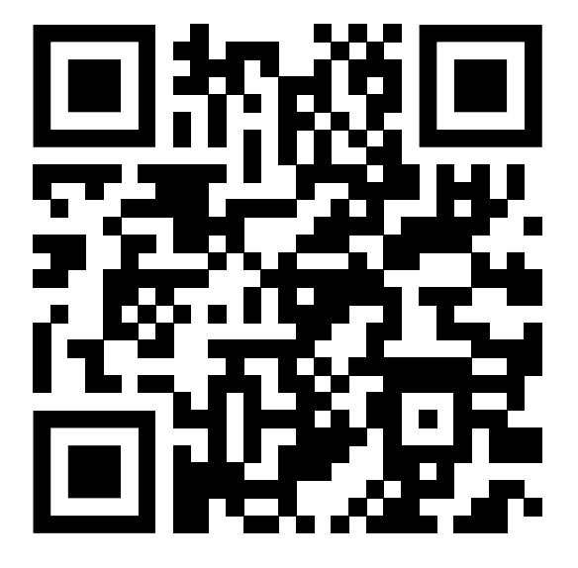
https://shorturl.at/flnM8
https://github.com/olarn/GoF-Design-Pattern

Slide 22
Thank you.

